Slide 1
Wrapping up!
Summer School UNSW 2019: Research Labs 8 & 9
Jennifer Sloane

Slide 2
Presentations

Slide 3
Presentation preparation
Take 45 minutes to begin working on your 5 minute presentation
You can find the template on OpenLearning

Slide 4
Memory Lecture

Slide 5
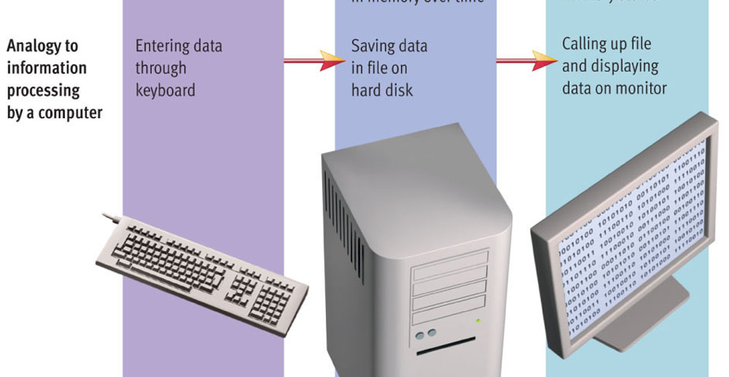
Memory
Encode
Storage
Retrieval

Slide 6
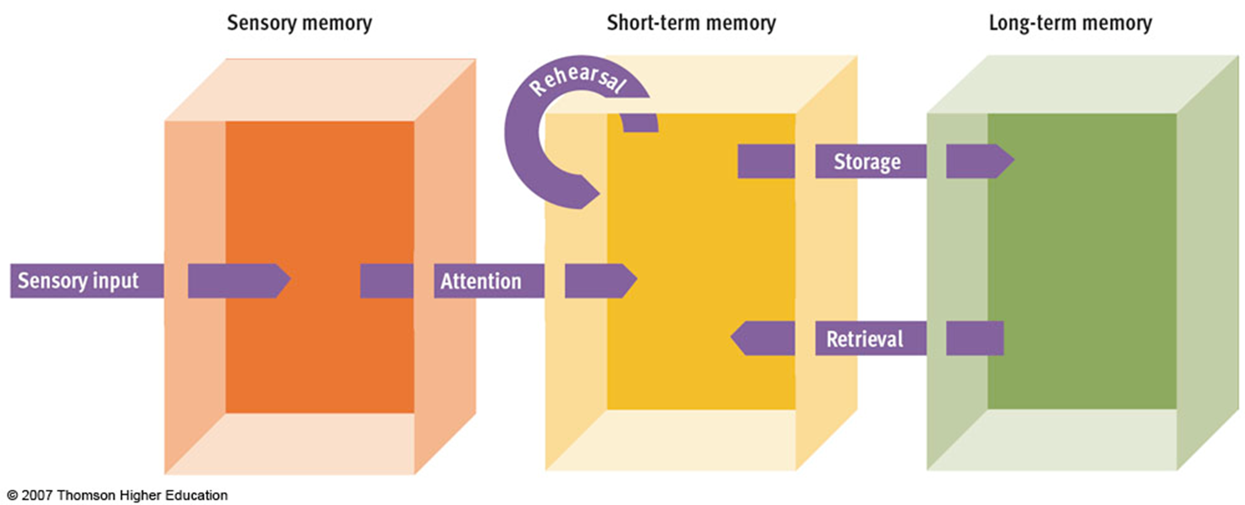
3 types of memory

Slide 7
Short term memory: Demo

Slide 8
I R S F B I M T V S U V

Slide 9
I R S F B I M T V S U V
Try again…
Chunking = grouping familiar stimuli into a single unit

Slide 10
Long term memory

Slide 11
Long Term Memory
Declarative
Procedural

Slide 12
Declarative vs. Procedural
Declarative
Factual information
Words, definitions, names, events, concepts…
Conscious, effortful process
More vulnerable to decay
Example: What is the capital of Australia?
Procedural
Memory for actions, skills, conditioned responses, emotional memories
Largely automatic process
Example: Riding a bike

Slide 13
Case Study: H.M.
https://www.youtube.com/watch?v=SQASyR0w8Qo
Declarative
Procedural

Slide 14
Declarative
Declarative
Factual information
Words, definitions, names, events, concepts…
Conscious, effortful process
More vulnerable to decay
Example: What is the capital of Australia?
Episodic
Semantic

Slide 15
Episodic vs. semantic
Episodic
Knowledge about personal experiences
Example: Family vacation to Bahamas
Analogy to books: like an autobiography
Semantic
General knowledge
Example: Christmas is December 25th
Analogy to books: like an encyclopedia

Slide 16
Long Term Memory: Summary

Slide 17
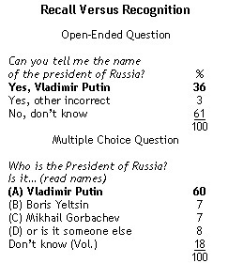
Recall vs. recognition
Recall
Memory test that requires a person to reproduce information WITHOUT any cues
Recognition
Memory test that requires a person to select previously learned information from an array of options

Slide 18
Memory activity
Notes:
Print out handout

Slide 19
Ways to improve memory
Elaboration = linking a stimulus to other information at the time of encoding
Thinking of examples
Visual Imagery = creation of visual images to represent words to be remembered
Easier for concrete objects
Self-Referent Encoding = Making information personally meaningful
https://www.youtube.com/watch?v=Lj3CvK1kALQ (51-59 mins & 101)
Notes:
Find 10 mins of video to watch

Slide 20
Activity: Memory Test
https://www.youtube.com/watch?v=drQ3i6EejPE

Slide 21
Let’s Test your Memory!

Slide 22
List
rest, tired, awake, dream, snore, bed, eat, slumber, sound, comfort, wake, night
Sleep?
Notes:
Primary and Recency Effect
Sleep? How many people swear I said it? I didn’t! Why do you think you remember the word sleep?
False memories, grouped all those words into concept of “sleep”
Sleep word list
Students put away pens/paper
Read the list of sleep related words aloud slowly
rest, tired, awake, dream, snore, bed, eat, slumber, sound, comfort, wake, night
Raise hand if you wrote down
Aardvark
Rest
Night
SLEEP

Slide 23
Other interesting videos…
Hyperthymesia: https://www.youtube.com/watch?v=B-uFDhJPKOc
Synesthesia: https://www.youtube.com/watch?v=rkRbebvoYqI
Awareness test: https://www.youtube.com/watch?v=z-Dg-06nrnc
Capgras delusion/imposter syndrome: https://www.youtube.com/watch?v=dqBGzkz1oDU&t=372s
Notes:
Hyperthymesia = 4 mins
Synesthesia = 4 mins
Awareness test = 1 min
Capgras delusion = 10 mins

Slide 24
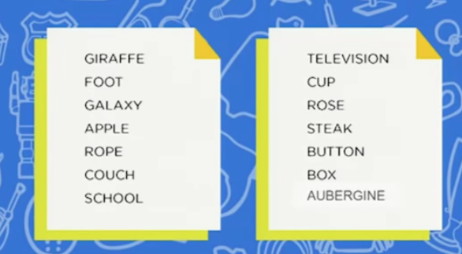
Do you remember the list of 14 items from the Memory Athletes video?

Slide 25
Ask a scientist!
Notes:
Print out handout

